Slide 1
MAC Spoofing Lab

Slide 2
MAC Spoofing Lab
In this Lab, you will learn how to spoof your computer’s MAC Address
Materials needed
Kali Linux Machine
Windows Machine (on the Kali Machine’s network)
Software Tools used
macchanger (Linux command)

Slide 3
Objectives Covered
Security+ Objectives (SY0-501)
Compare and Contrast types of attacks
Application/Service Attacks
MAC Spoofing
DHS CAE Units
CTH – Describe different types of attacks and their characteristics

Slide 4
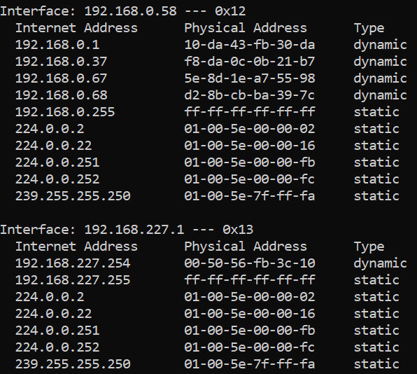
What is a MAC Spoofing Attack?
A MAC Address is a permanent unique address that identifies a machine via its network interface
If crime occurs, Network Operations and Law Enforcement can check the forensics logs for a MAC address of the attacking machine to positively identify the source.
What happens if someone “spoofs”, or changes, the MAC address?
MAC Addresses on a network
Notes:
Bank: Chase
Username: jsmith17 Password: @pp13s33d

Slide 5
The MAC Spoofing Lab
Setup the Machines
The MAC Address
Verify the MAC Address
Spoof the MAC Address
Verify the Spoofed Mac Address
Your Turn - Any MAC Address

Slide 6

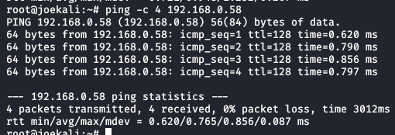
Set up the Machines
Log into the Kali Machine*
Log into the Windows Machine*
Ensure the devices can communicate over the network
In Windows, use the ipconfig command in the Command Prompt
Locate the IP Address of the machine
In Kali, in the Terminal run:
ping Windows_IP_Address
This should verify connectivity
*Note: This lab may not work in cyber ranges that use remote desktops since the network will be disabled and reset momentarily

Slide 7
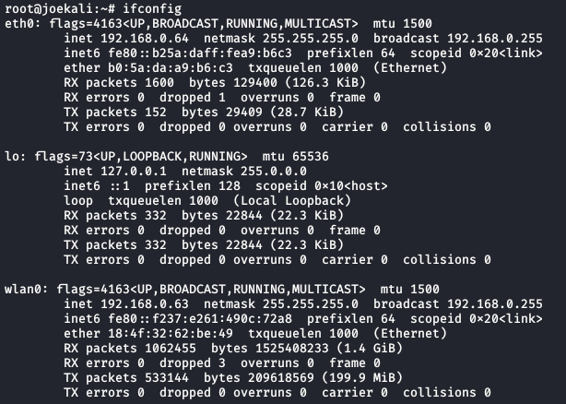
The MAC Address
Find the MAC Address on the Kali machine
In the Terminal, use the ifconfig command
Locate the MAC Address (follows ether)
Also locate the network name
Will be eth# if a wired network
Will be wlan# if a wireless network
(Where # is the number of the network interface)
MAC Address

Slide 8
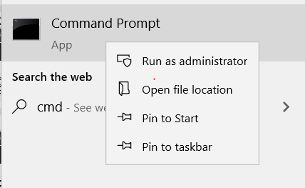
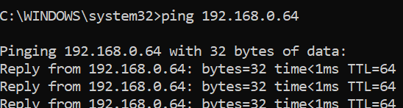

Verify the MAC Address
Verify the MAC Address on Windows
When opening Command Prompt, right-click
Select “Run as Administrator”
Use the arp command to show addresses on the network
arp -a
You will probably not see the Kali Machine at first
Ping the Kali Machine
ping Kali-IP-Address
Now use the arp command to find the Kali Machine
arp –a
You should now be able to see the Kali MAC Address
Should be same MAC Address

Slide 9
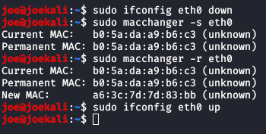
Spoof the MAC Address
In Kali, disable the network
sudo ifconfig network_name down
Check the MAC Address in macchanger*
sudo macchanger -s network_name
Change the MAC Address (random)
sudo macchanger -r network_name
Reenable network
sudo ifconfig network_name up
*Use the following command to install macchanger (if not already installed):
sudo apt-get install macchanger -y

Slide 10
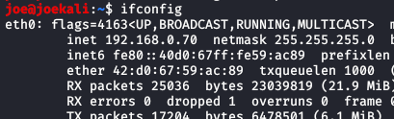
Verify the Spoofed MAC Address
In Kali, check the MAC Address
sudo ifconfig
Notice the IP Address changed too!*
In Windows, ping the new IP Address
ping Kali_IP_Address
List the IP Address
arp -a
You should see the new MAC Address
Verify the new MAC Address
*Why did you get a new IP address? It's the same computer, right?

Slide 11
Your Turn - Any MAC Address
Set to any MAC Address you want
Set the MAC Address to whatever you want
Disable network
Assign new MAC Address
macchanger -m ##:##:##:##:##:## network_name
Reenable network
Verify the new MAC Address
Why is an attacker’s ability to spoof as any MAC Address dangerous?

Slide 12
How to Defend Against MAC Spoofing
Difficult to defend against
Could be legitimate user or someone spoofing their address
Should you trust MAC Addresses?
How easy was it to spoof your MAC Address?
Network Access Control methods help thwart spoofing attacks
[Covered in 2.1.10 and Unit 4]
How else can you defend against MAC Spoofing?

